Slide 2
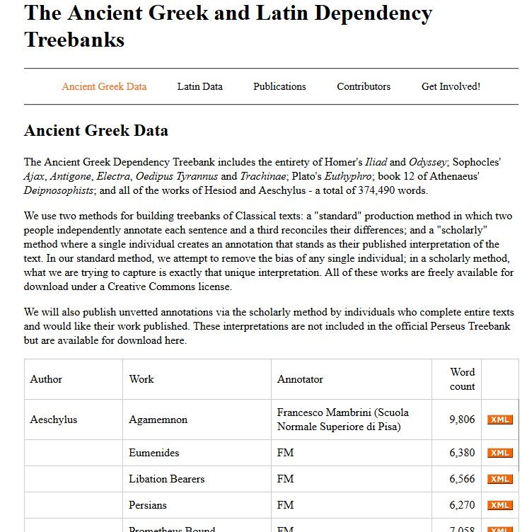

Slide 3
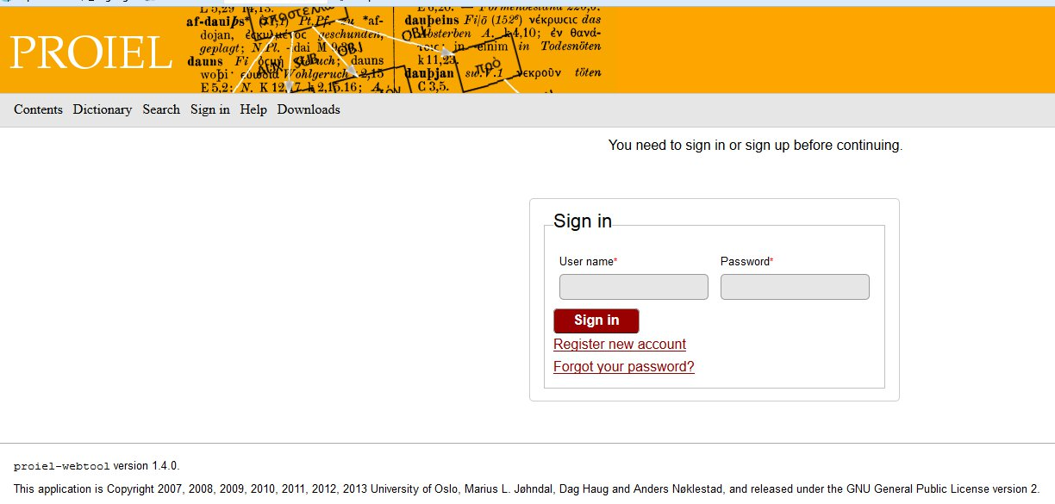

Slide 4
For each word in AGDT we have:
dependency (word’s parent, children)
syntactic relation (grammatical label for dependency)
Lemma
Morphology
Position in sentence

Slide 5
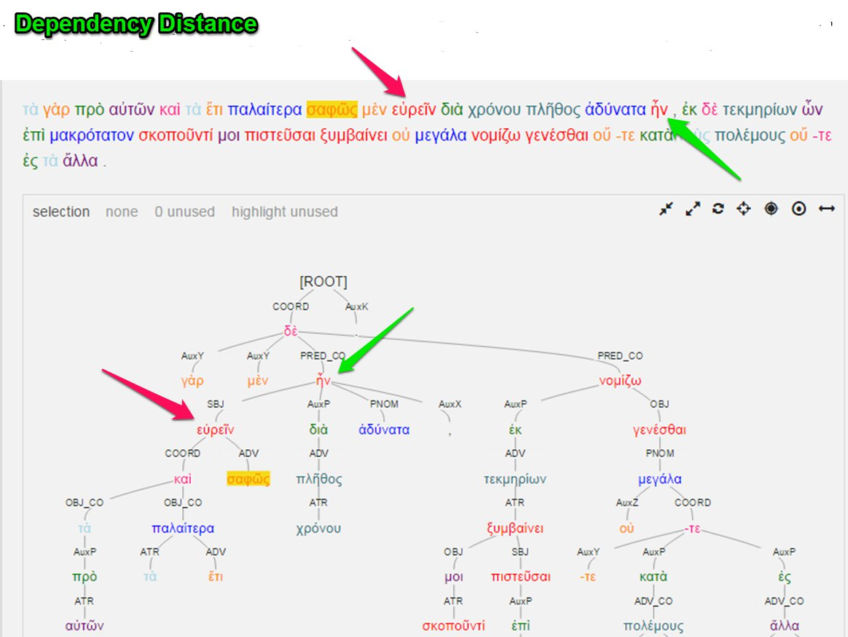

Slide 6
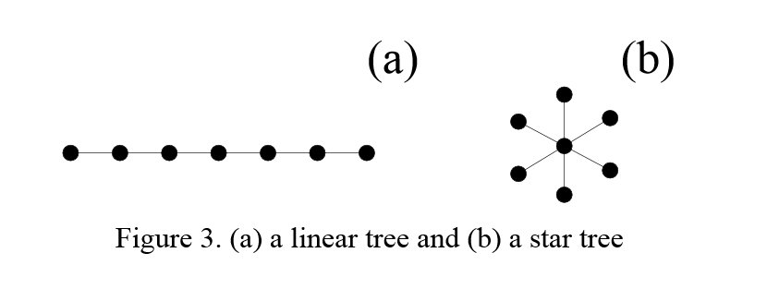
Dependency Degree
Linear vs. hubby structure

Slide 7
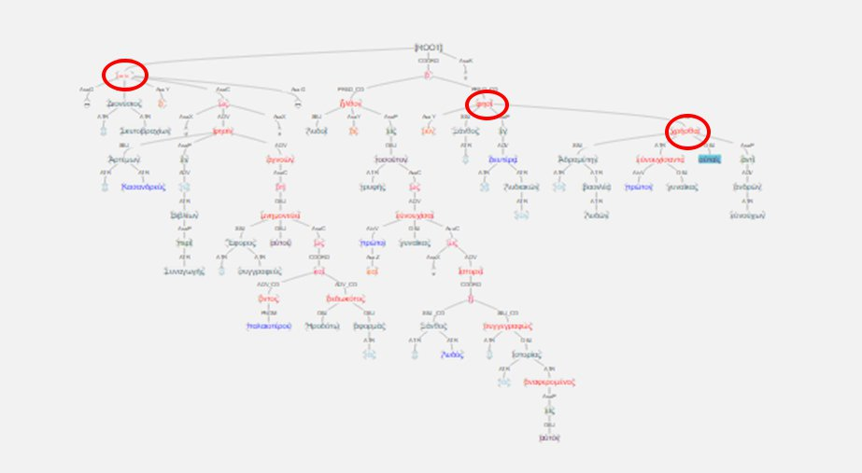

Slide 8
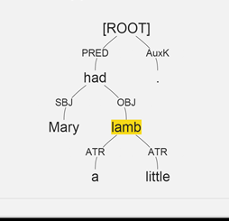

Slide 9
Mary: SBJ-PRED-ROOT
had: PRED-ROOT a: ATR-OBJ-PRED-ROOT little: ATR-OBJ-PRED-ROOT lamb: OBJ-PRED-ROOT

Slide 10
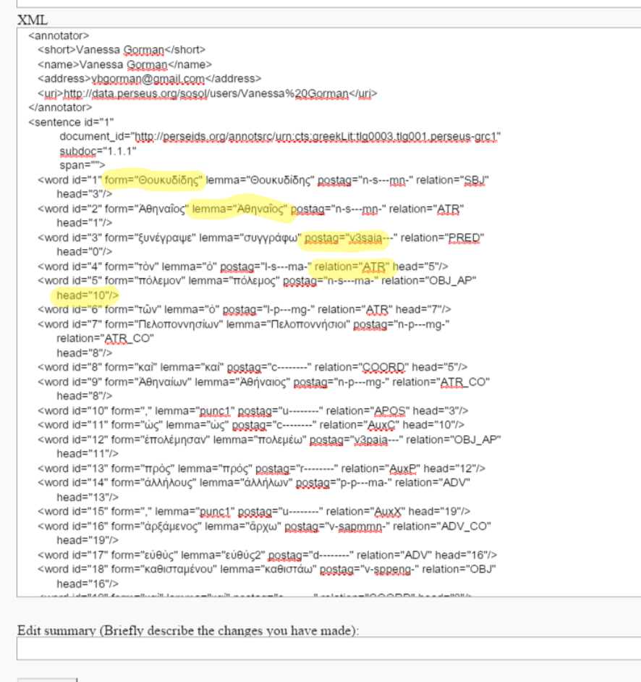

Slide 11
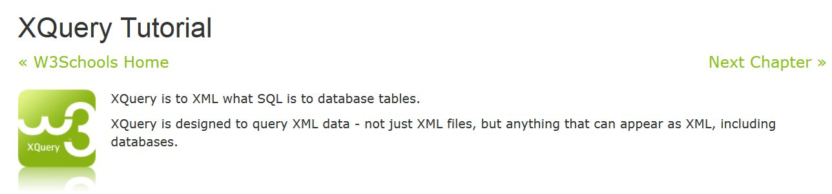
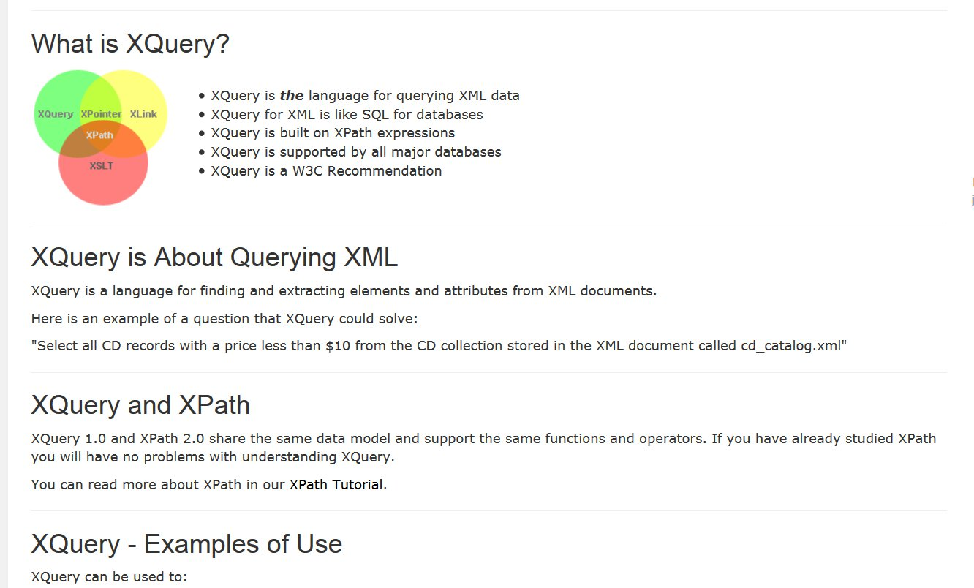

Slide 12
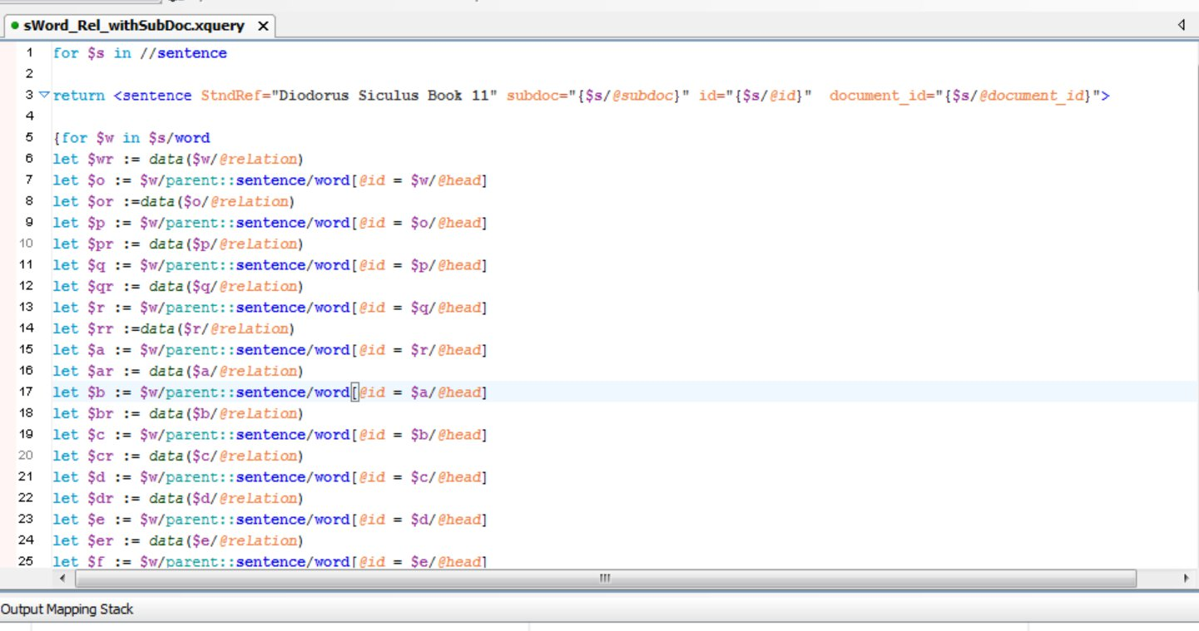

Slide 13
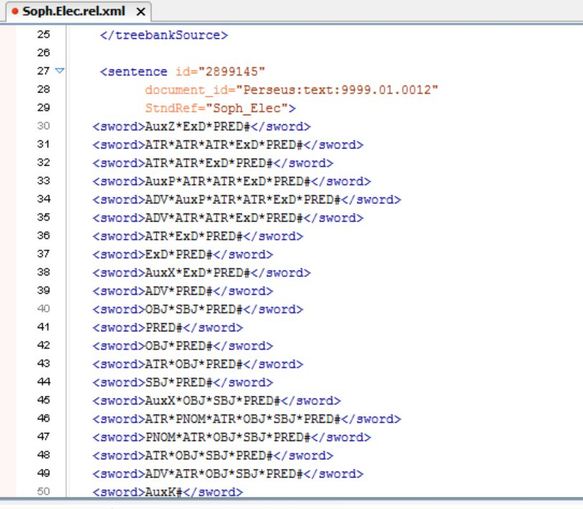
Ὦ τοῦ στρατηγήσαντος ἐν Τροίᾳ ποτὲ / Ἀγαμέμνονος παῖ
"O child of Agamemnon, once leading an army at Troy"

Slide 14
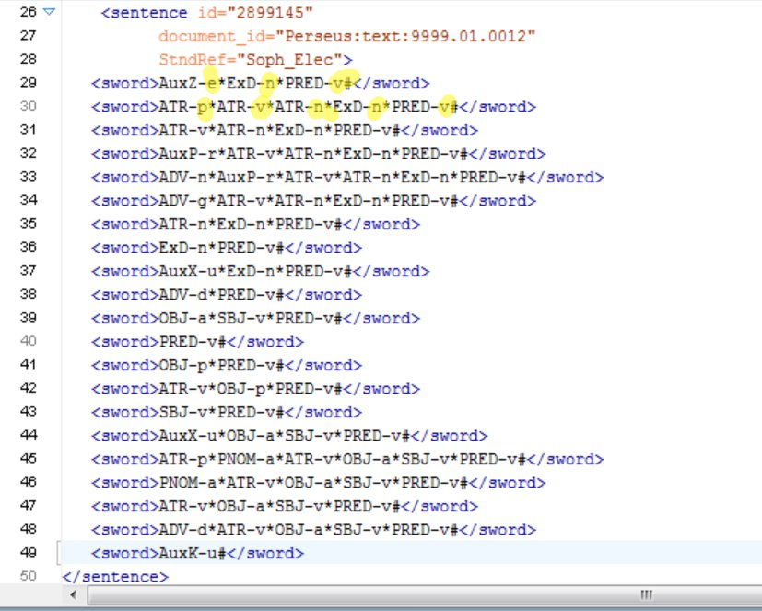
Ὦ τοῦ στρατηγήσαντος ἐν Τροίᾳ ποτὲ / Ἀγαμέμνονος παῖ
"O child of Agamemnon, once leading an army at Troy"

Slide 15
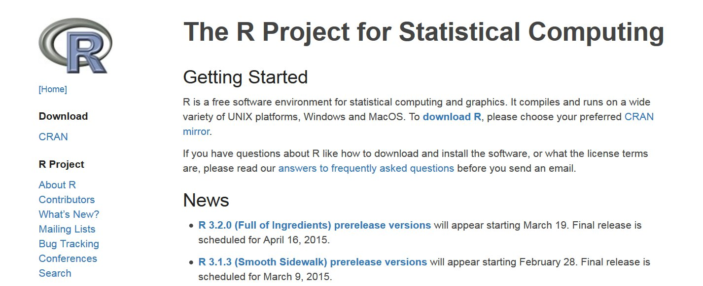

Slide 16
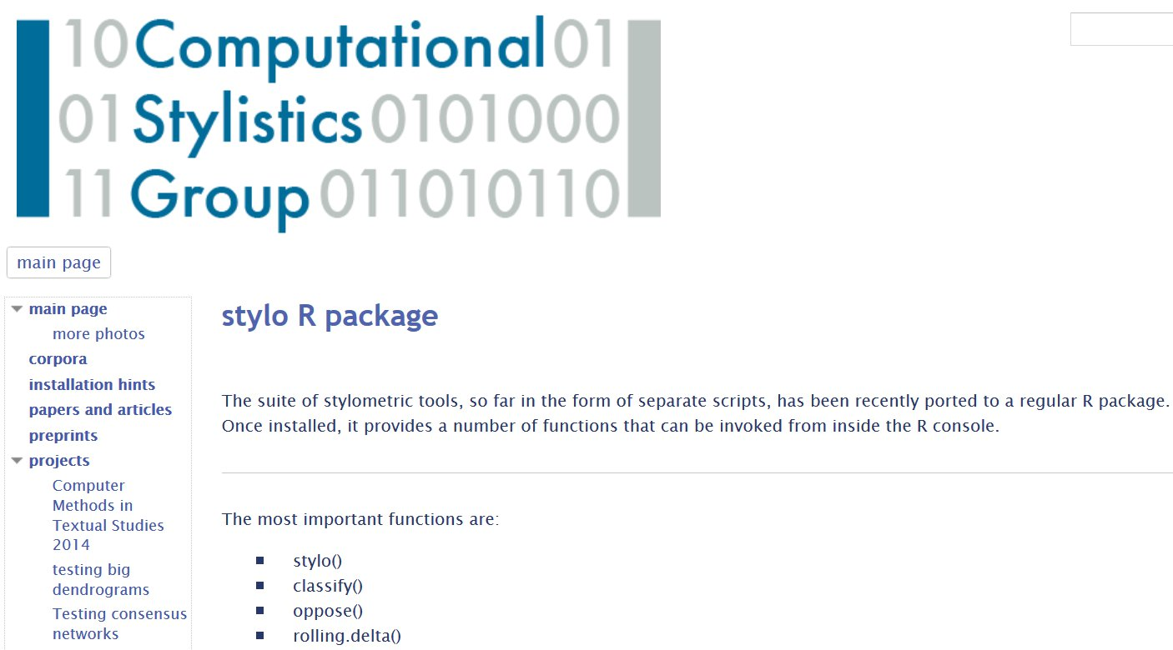

Slide 17
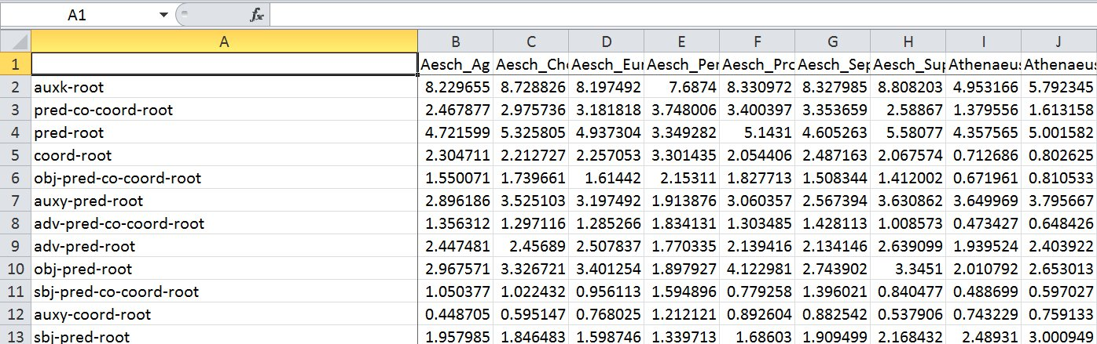

Slide 18
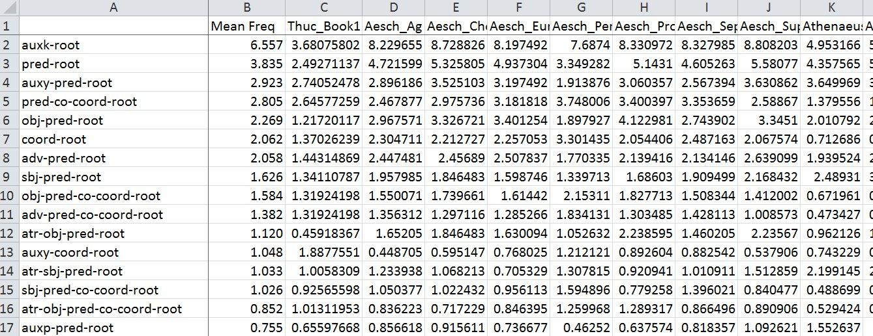

Slide 19
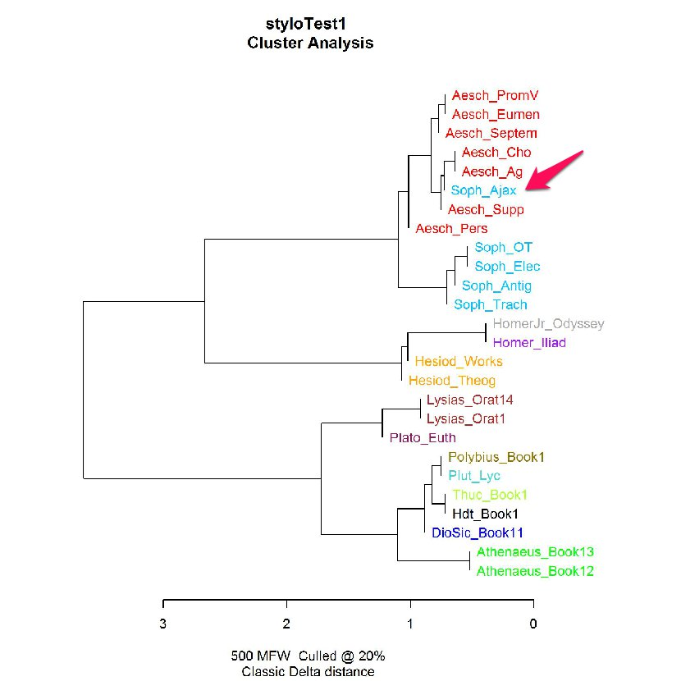

Slide 21
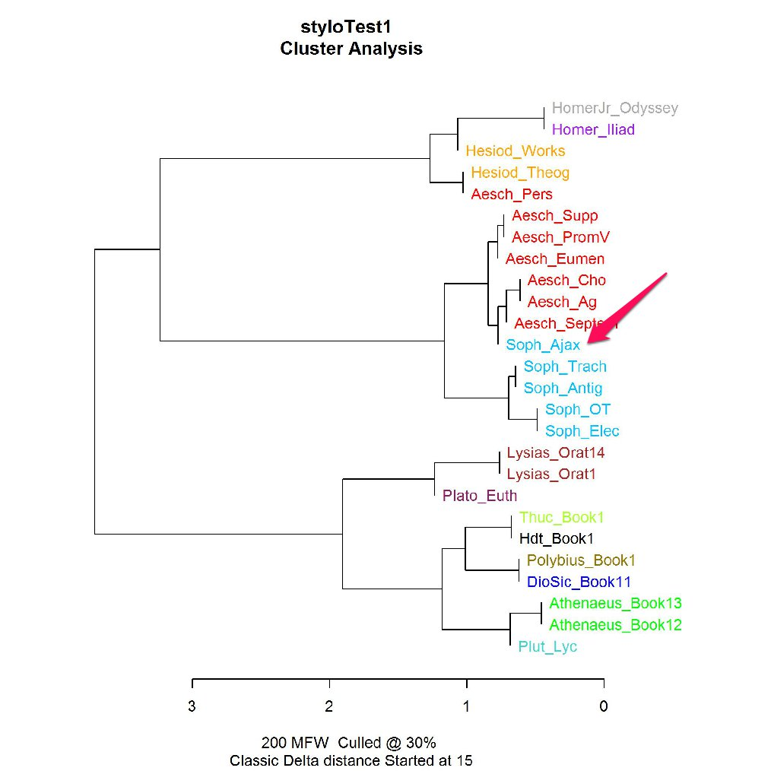

Slide 23
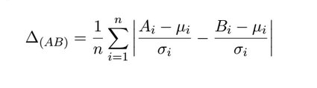
Burrows Delta

Slide 24
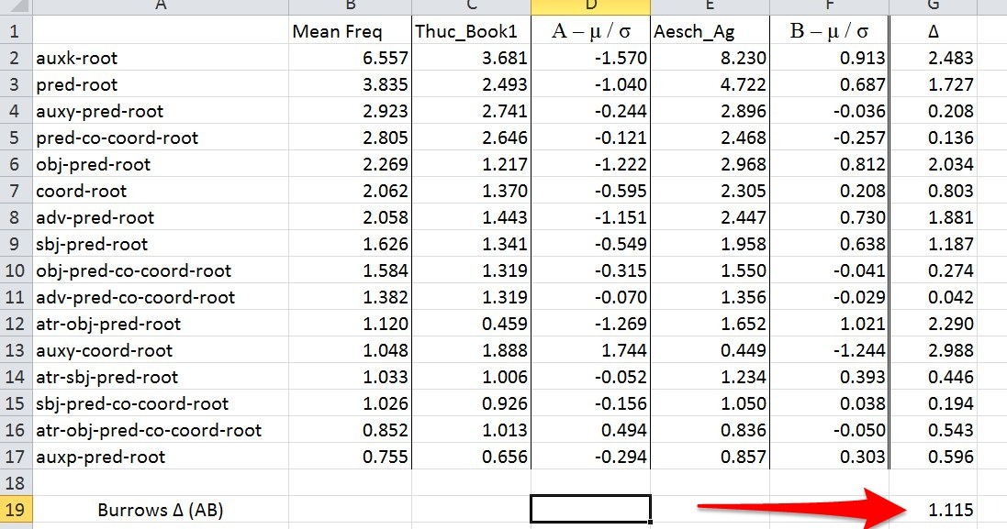

Slide 25
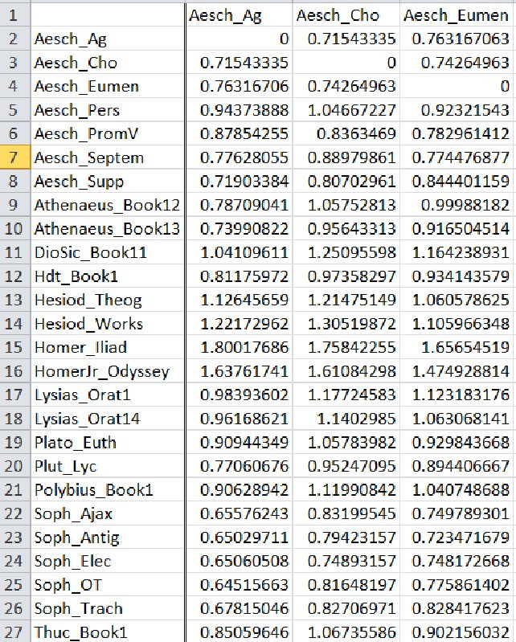

Slide 26
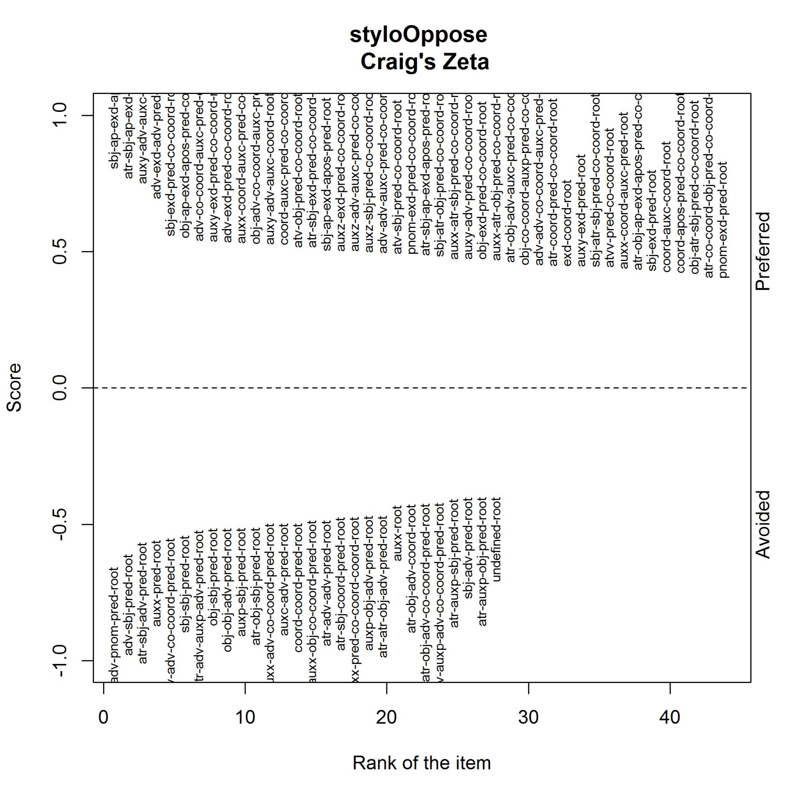

Slide 27
Craig’s Zeta
Divide corpus 1 into segments of equal size (size = n)
Segments with at least 1 example of given feature are hits.
Each hit is worth 1 point.
Hit
Hit
Hit
Hit
Hit
Hit
Hit
Hits/segments = preferred feature score
Divide corpus 2 into segments of size n.
Segments with no examples of feature are misses.
Each miss is worth -1 point.
Miss
Miss
Miss
Miss
Miss
Miss
Miss
Miss
Misses/segments = avoided feature score

Slide 29
Thucydides

Slide 30
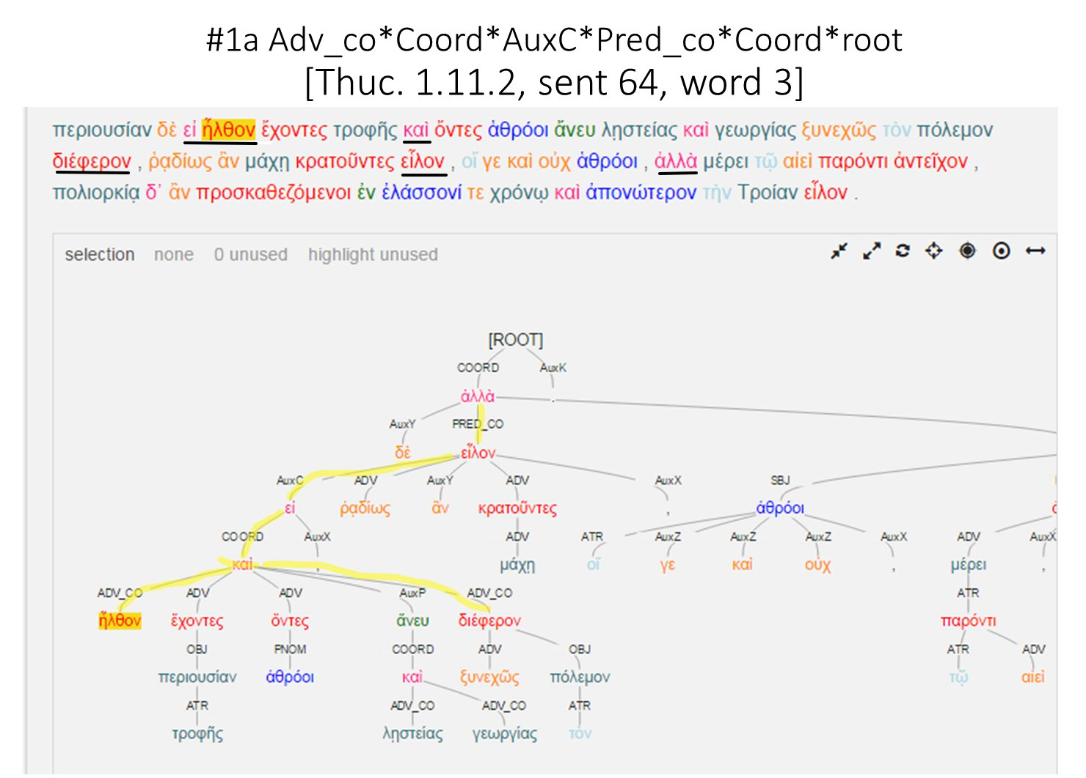

Slide 31
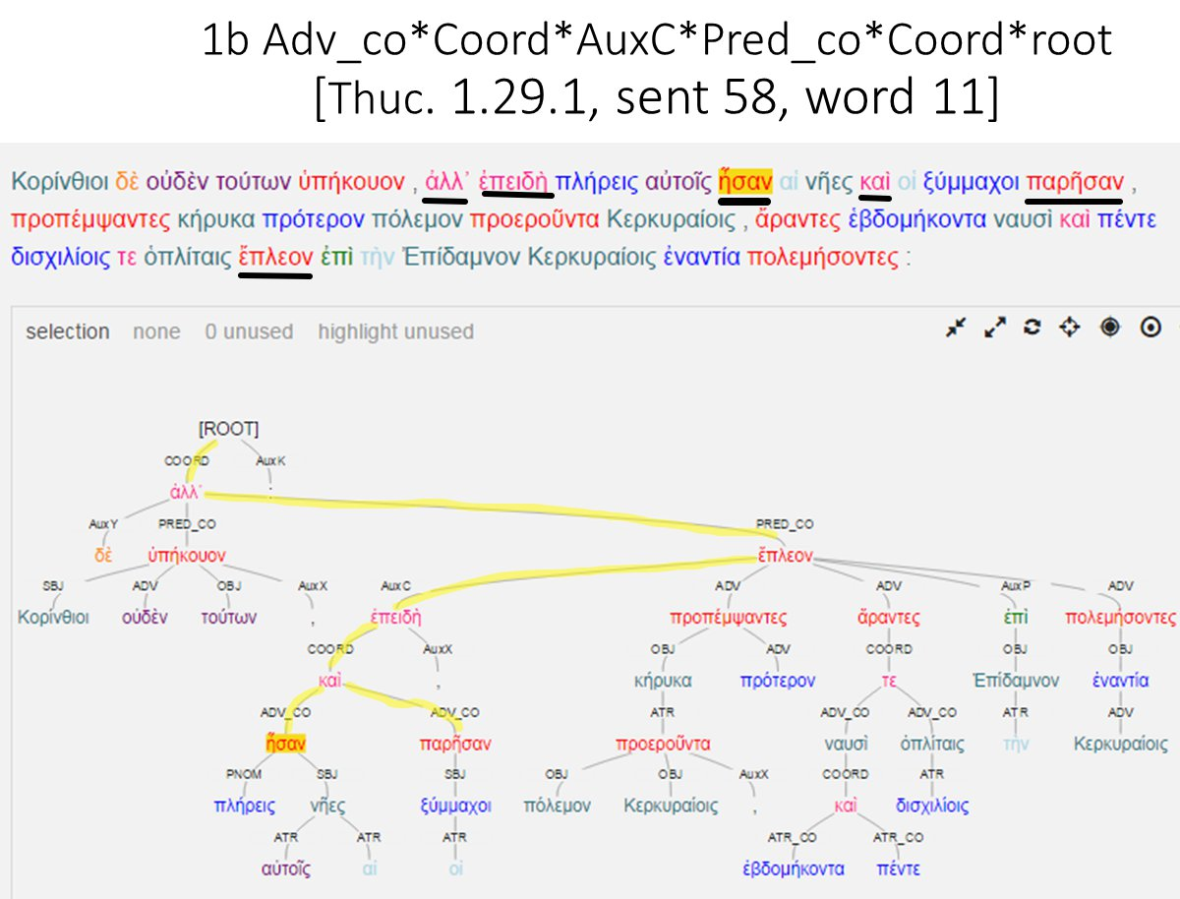

Slide 32
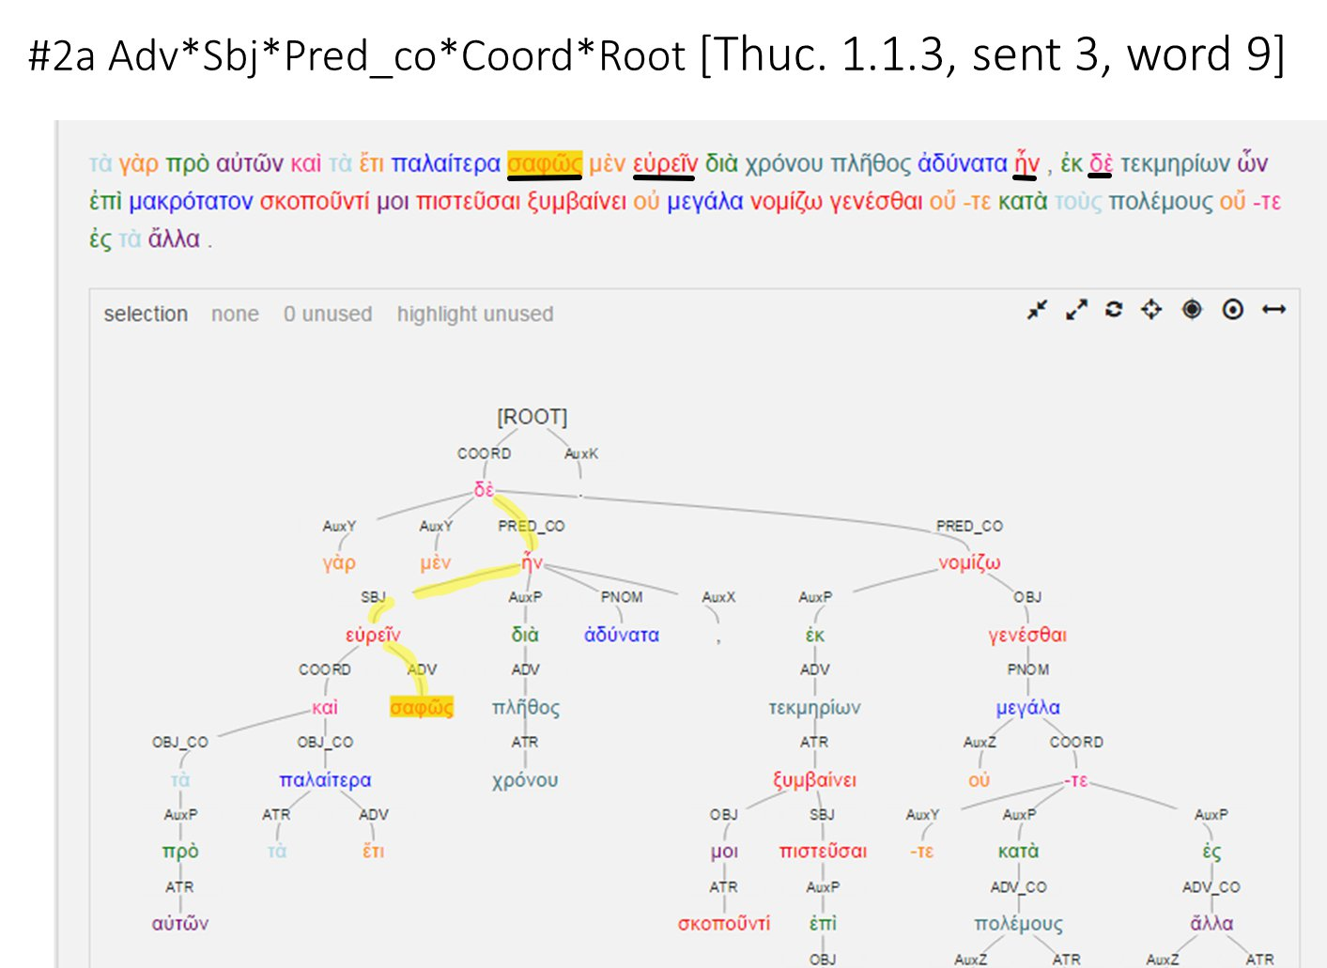

Slide 33
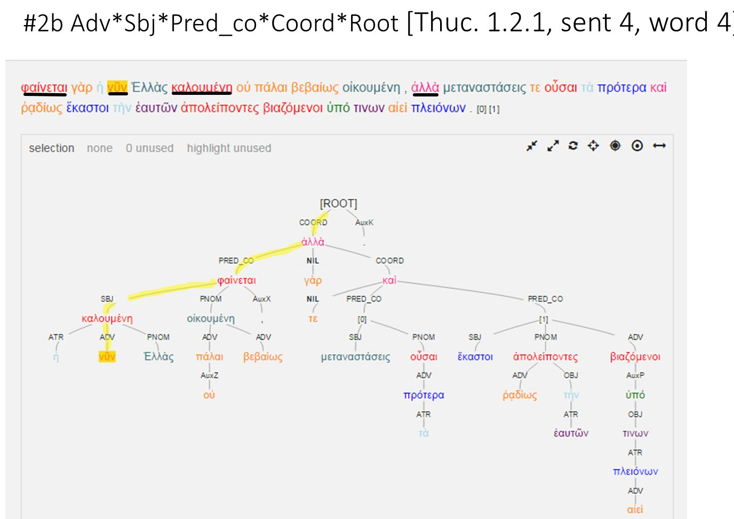

Slide 34
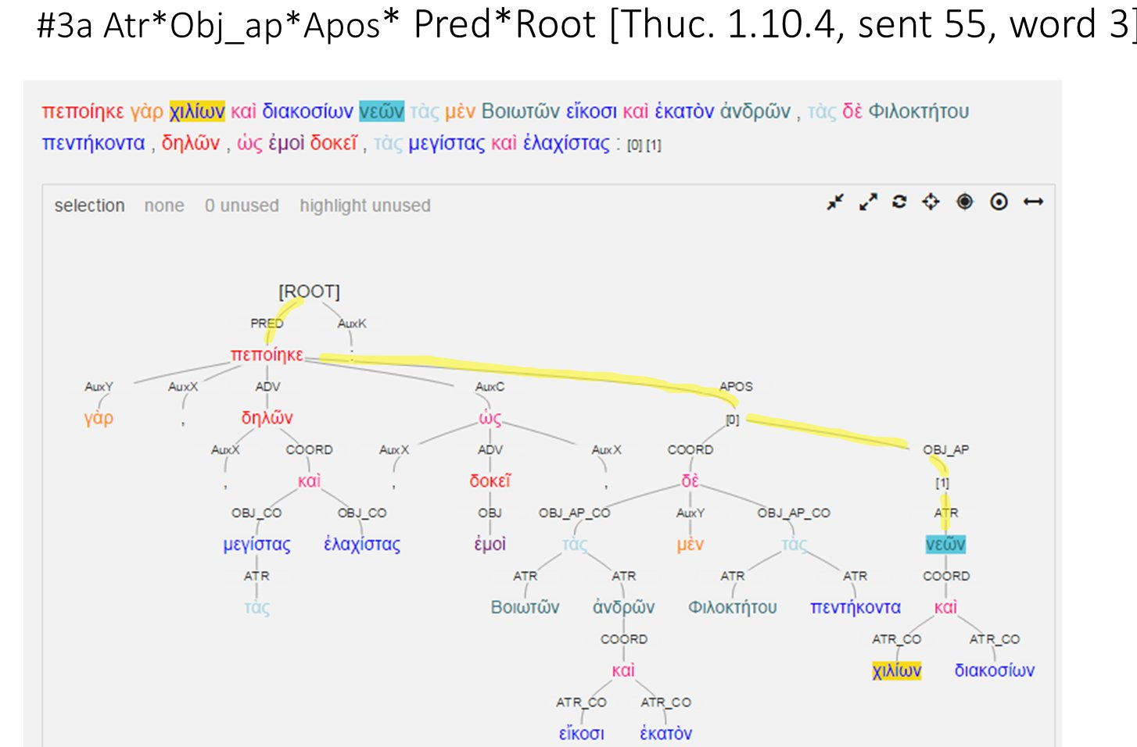

Slide 35
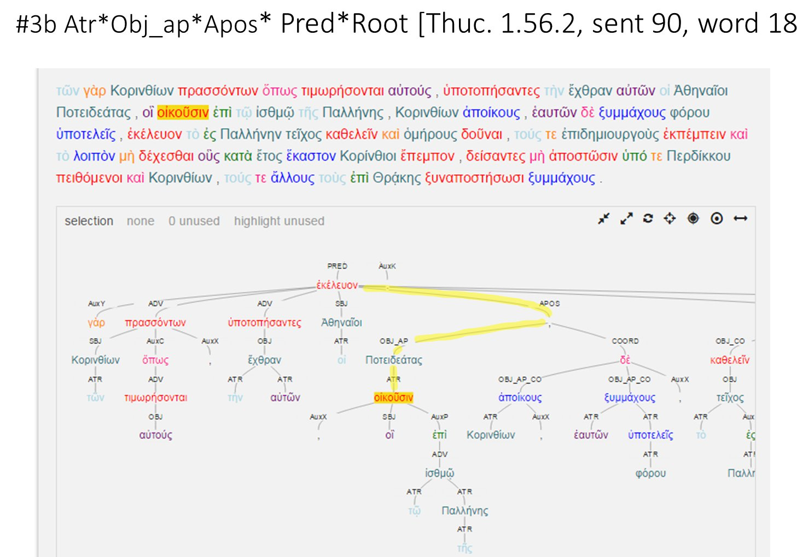

Slide 36
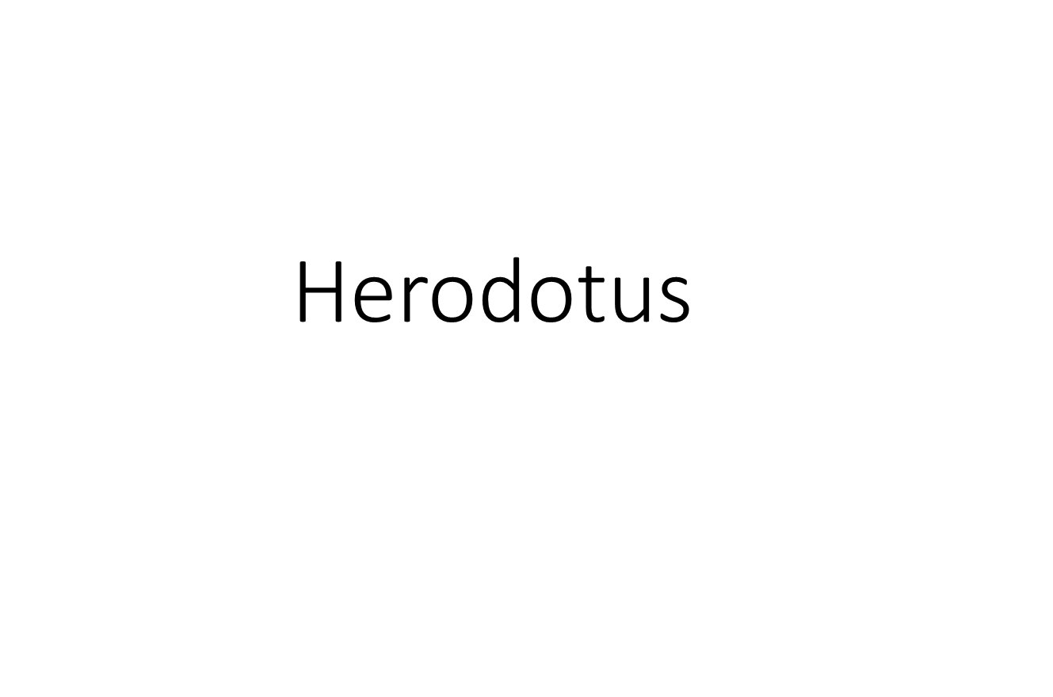

Slide 37
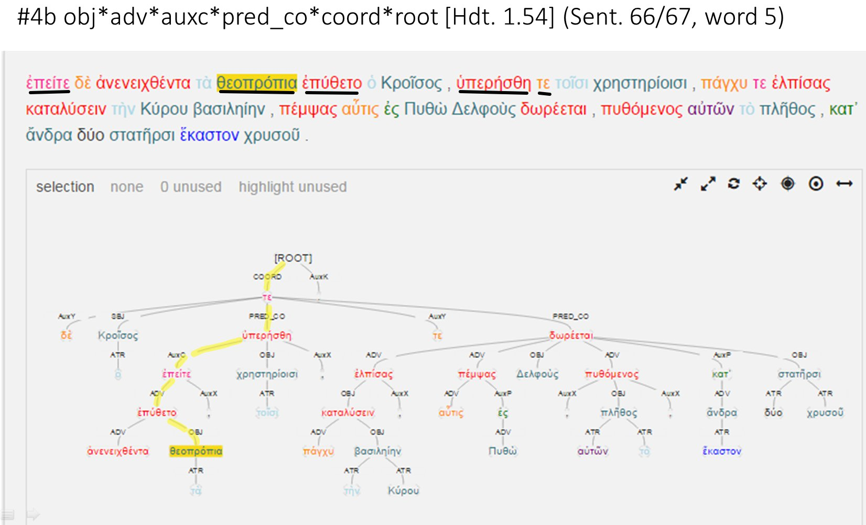

Slide 38
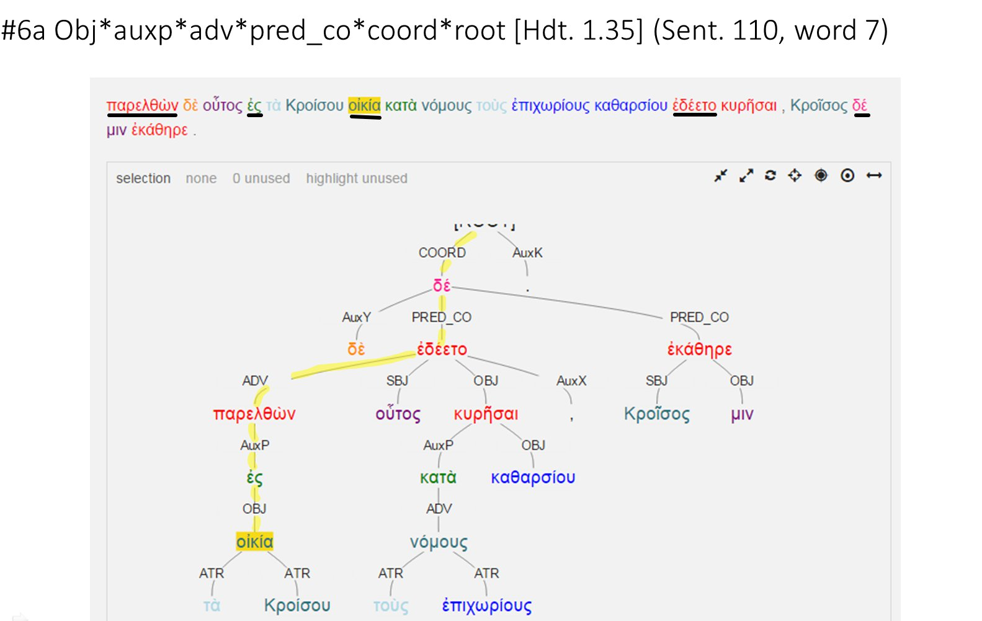

Slide 39
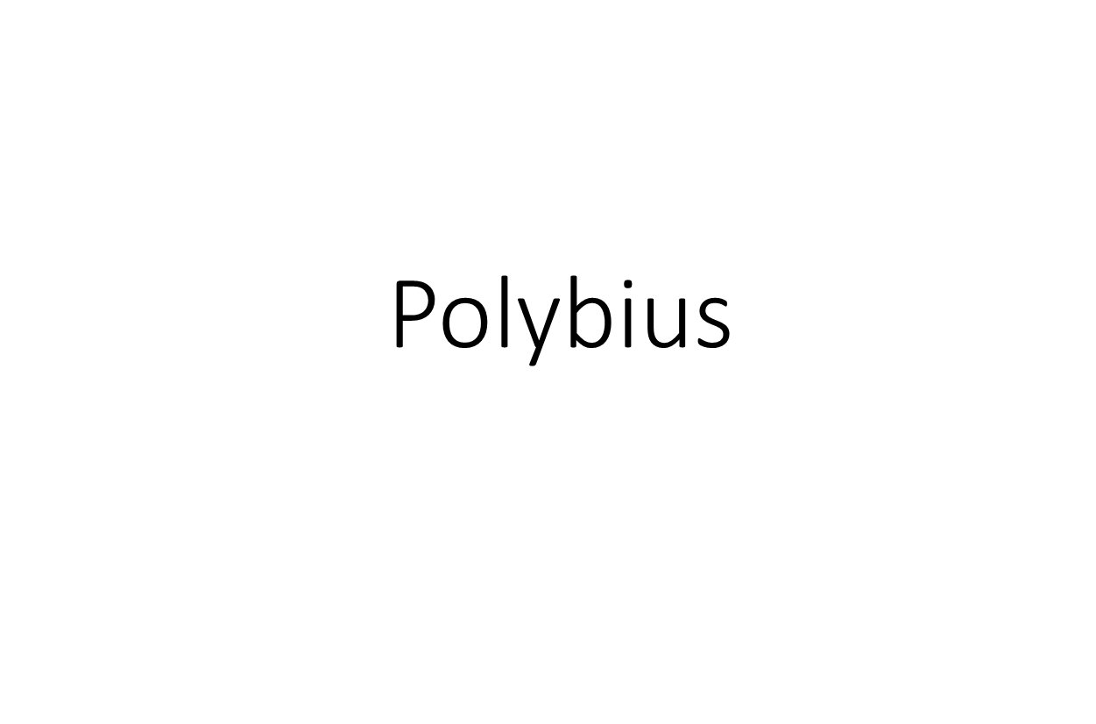

Slide 40
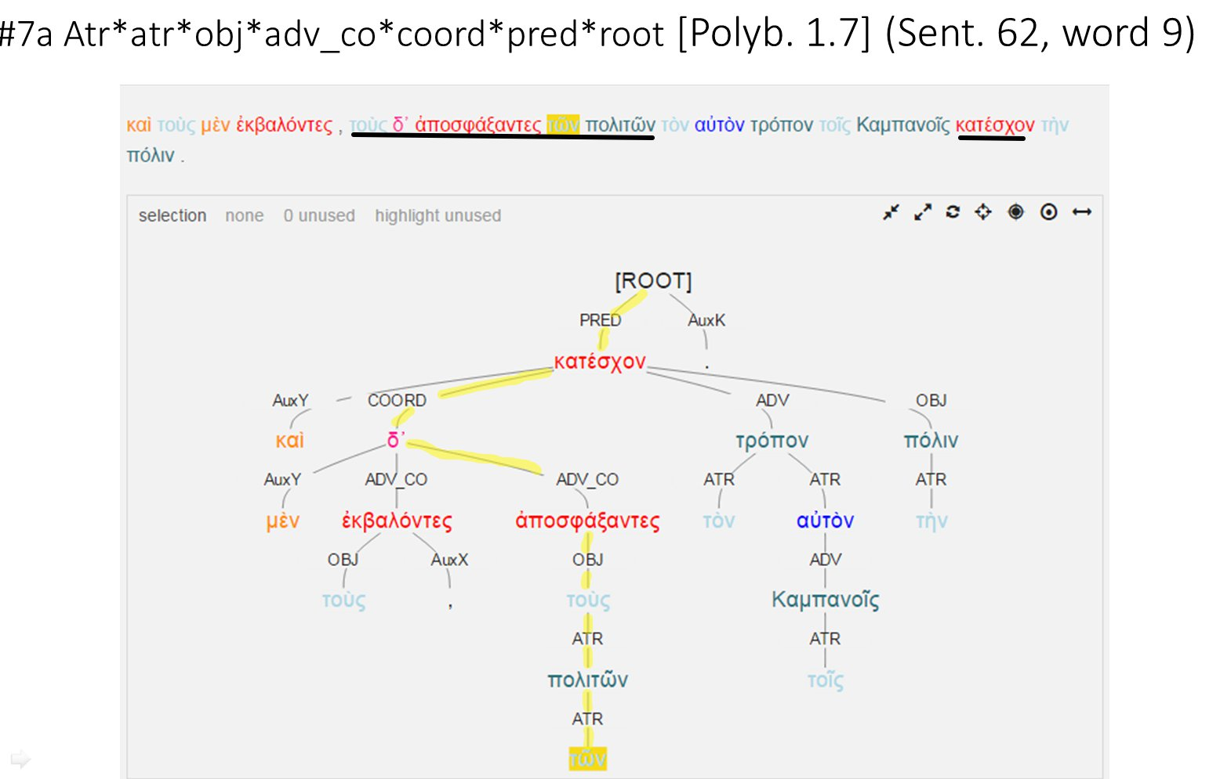

Slide 41
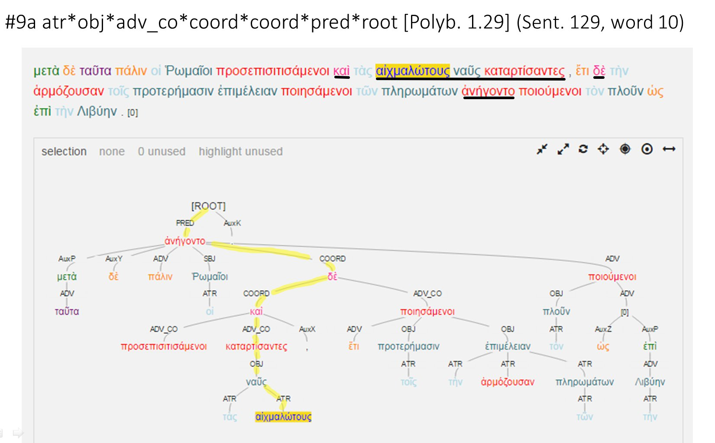

Slide 42
Homer

Slide 43
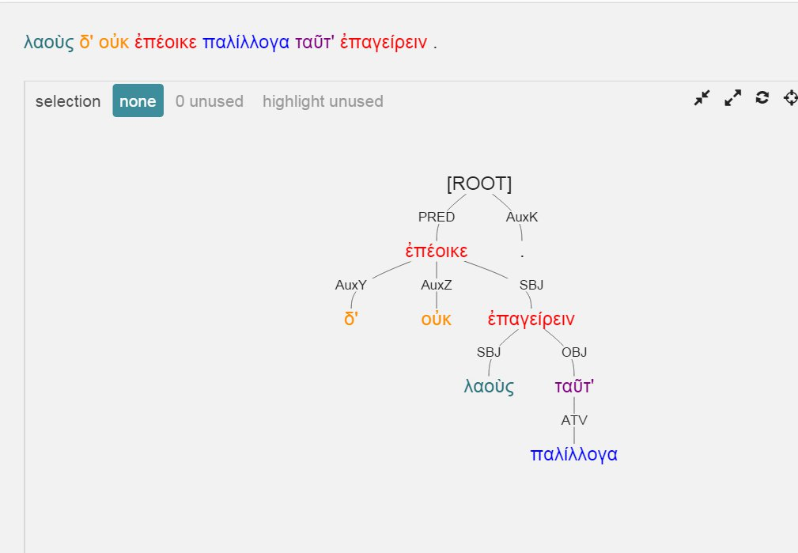

Slide 44
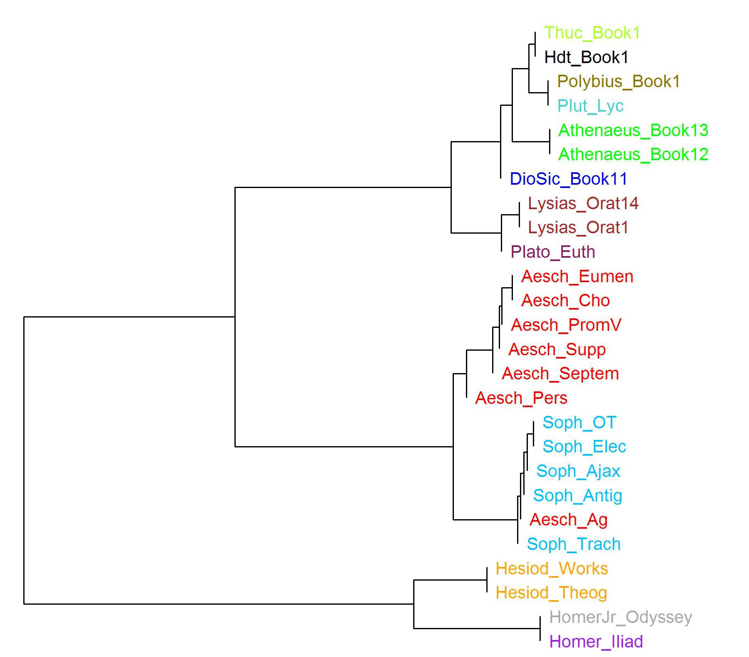

Slide 45


Slide 46
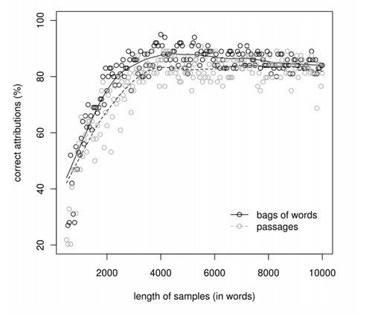
Maciej Eder

Slide 47
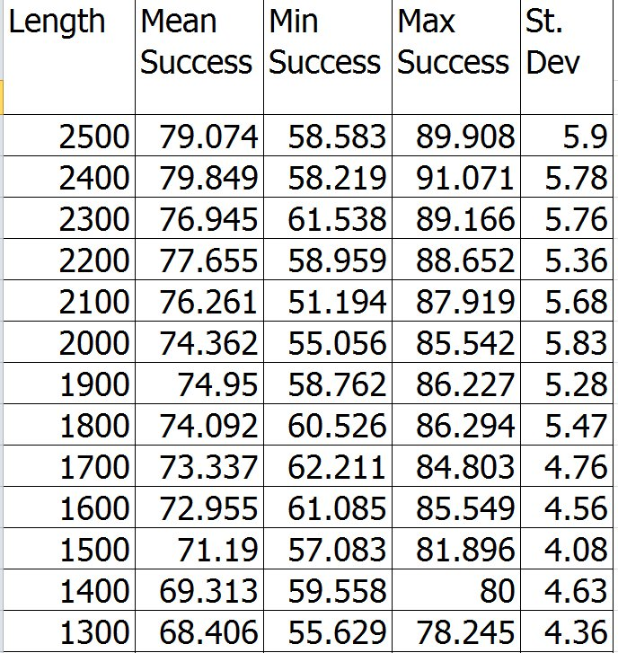

Slide 48
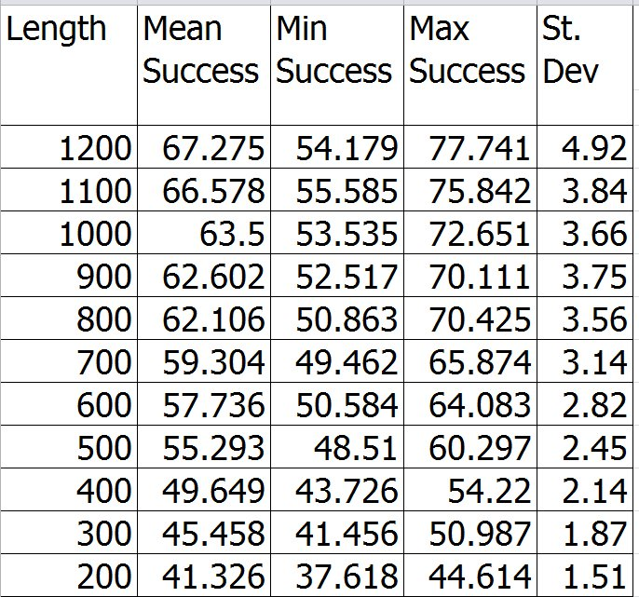

Slide 49
What Next?
Test! Test! Test!
Cast the net as widely as possible:
Many flavors of sWord
With POS, with Dependency Distance …
N-grams
Many computational approaches

Slide 50
What next?
Test! Test! Test!
Aim directly at research question
Athenaeus and fragments
Are fragments of single author distinguishable according to transmitting source?

Slide 51
What’s needed?
Trees! Trees! Trees!
Metadata
Digital Athenaeus
Digital Fragmenta Historicorum Graecorum
Scalable workflow
Stable identification for each token

Slide 52
The Vision Thing
Treebanker’s Eutopia
Real time feedback for annotators
Is this syntactic structure feasible?
Is this structure prone to inter-annotator disagreement?
Philoligist’s Elysium
Real time feedback for close readers
How does this text compare to others:
Lexically, syntactically, semantically?
Pragmatically, acoustically, etc.?

